Slide 1
Online Retail :report
Presented by:Ammu Fredy

Slide 2
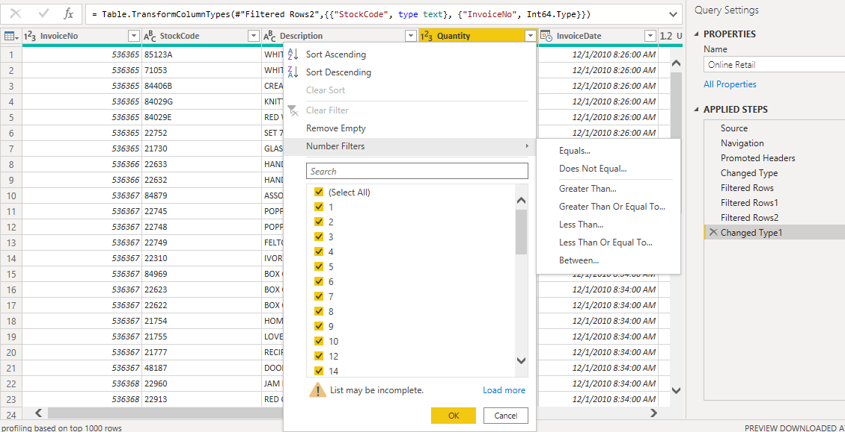
Data Cleaning
Quantity not less than 1
Unit Price not less than 0

Slide 3
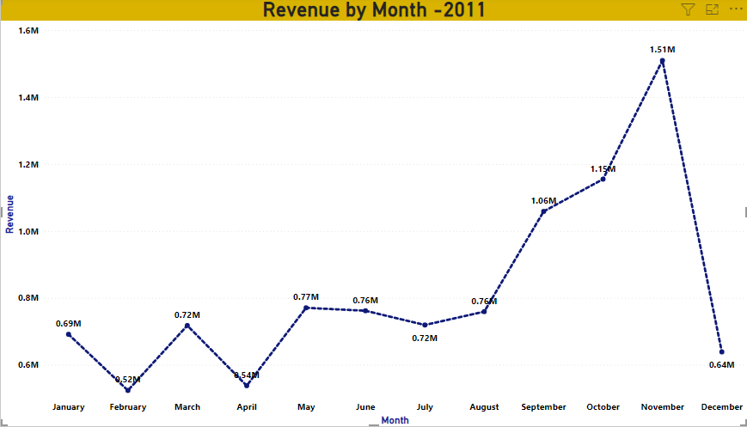
At the end of year revenue drop to .64 M

Slide 4
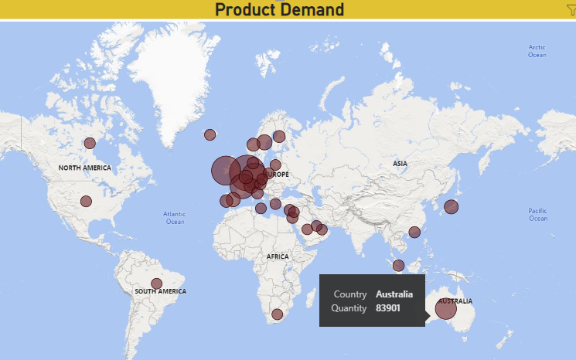
After Europe ,Australia is showing high demand in products.

Slide 5
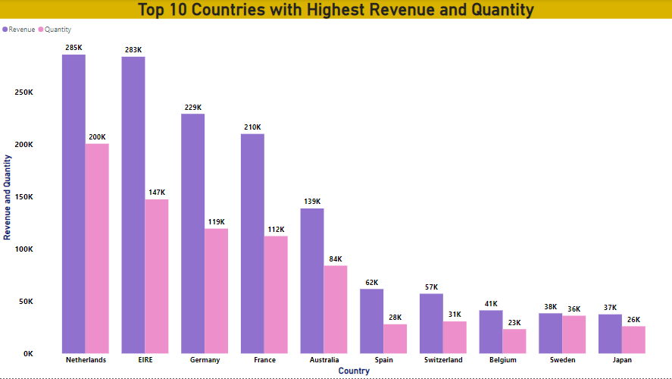

Slide 6
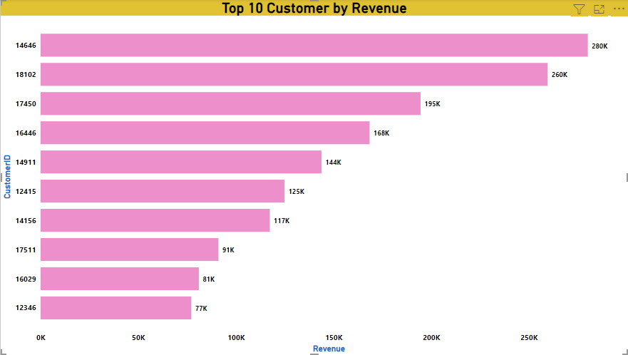

Slide 7
Thank you

